Slide 1

Programming the Android Platform
The Activity Class
(Notes#2)

Slide 2
The Activity Class
One application component type
Provides a visual interface for a single screen
Typically supports one thing a user can do, e.g.,
View an email message
Show a login screen
Applications usually include several activities

Slide 3
Tasks
A Task is a set of related Activities
not necessarily provided by the same application package
Android manages a system Activity stack
Launching activity places it on top of the stack
Hitting back button pops activity off the stack

Slide 4
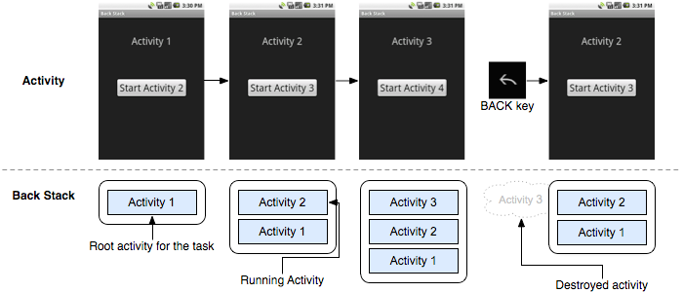
Task Stack
developer.android.com/guide/topics/fundamentals/tasks-and-back-stack.html

Slide 5
Activity States
Not started – not yet created
Active
Resumed/Running - visible, has focus
Paused - visible, does not have focus, can be terminated
Stopped - not visible, does not have focus, can be terminated
Finished – done

Slide 6
The Activity Lifecycle
Android communicates state changes by calling an Activity’s lifecycle methods

Slide 7
Activity Lifecycle Methods
protected void onCreate()
protected void onStart()
protected void onResume()
protected void onPause()
protected void onRestart()
protected void onStop()
protected void onDestroy()

Slide 8
The Activity Lifecycle (1)

Slide 9
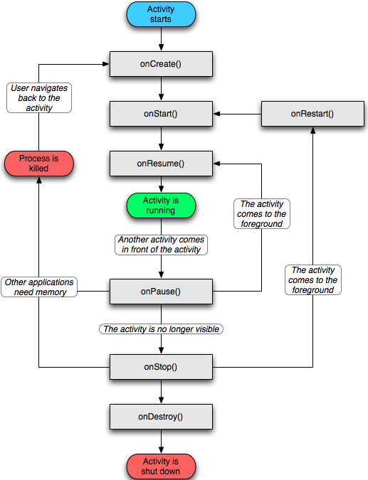
The Activity Lifecycle (2)

Slide 10
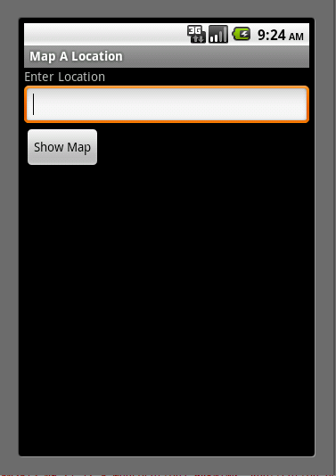
MapLocation

Slide 11
onCreate()
Activity is being created
Setup global state
Call super.onCreate()
Inflate UI views
Configure views as necessary
Set the activity’s content view

Slide 12
MapLocation.onCreate()
public void onCreate(Bundle savedInstanceState) {
super.onCreate(savedInstanceState);
setContentView(R.layout.main);
final EditText addressfield = (EditText) findViewById(R.id.location);
final Button button = (Button) findViewById(R.id.mapButton);
button.setOnClickListener(new Button.OnClickListener() {
public void onClick(View v) {
try {
String address = addressfield.getText().toString();
address = address.replace(' ', '+');
Intent geoIntent = new Intent(android.content.Intent.ACTION_VIEW, Uri.parse("geo:0,0?q=" + address));
startActivity(geoIntent);
} catch (Exception e) {}
}
});
}

Slide 13
onStart()
Activity about to become visible

Slide 14
onRestart()
Called if the Activity has been stopped and is about to be started again

Slide 15
onResume()
About to start interacting with user

Slide 16
onPause()
Focus about to switch to another Activity
Typical actions
Saved persistent state
Shutdown unneeded behavior

Slide 17
onStop()
Activity is no longer visible to user

Slide 18
onDestroy()
Activity is about to be destroyed

Slide 19
Starting Activities
Create an Intent object specifying the Activity to start
We’ll discuss Intents in later lectures
Pass newly created Intent to one of the following methods
startActivity()
StartActivityForResult()
receive callback when called Activity finishes

Slide 20
startActivity()
protected void onCreate(Bundle savedInstanceState) {
…
public void onClick(View v) {
…
Intent geoIntent = new Intent(android.content.Intent.ACTION_VIEW, Uri.parse("geo:0,0?q=" + address));
startActivity(geoIntent);
…
}
…
}

Slide 21
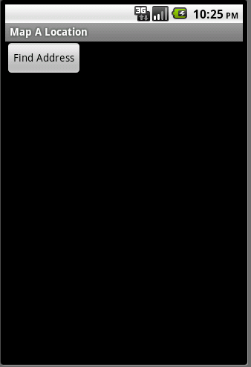

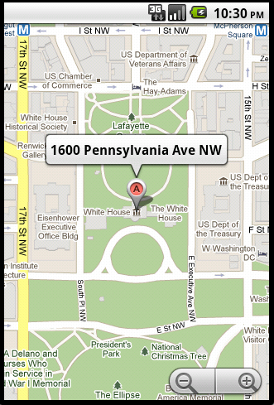
MapLocationFromContacts
*Not really my address ☺

Slide 22
startActivityForResult()
protected void onCreate(Bundle savedInstanceState) {
…
public void onClick(View v) {
try {
Intent intent = new Intent(Intent.ACTION_PICK,
ContactsContract.Contacts.CONTENT_URI);
startActivityForResult(intent, PICK_CONTACT_REQUEST);
} catch (Exception e) {}
}
});
}

Slide 23
startActivityForResult() (cont.)
protected void onActivityResult(int requestCode, int resultCode, Intent data) {
if (resultCode == Activity.RESULT_OK && requestCode == PICK_CONTACT_REQUEST) {
…
String address = / * extract address from data */
Intent geoIntent = new Intent(android.content.Intent.ACTION_VIEW,
Uri.parse("geo:0,0?q=" + address));
startActivity(geoIntent);
}
}

Slide 24
Configuration Changes
Device configuration can change at runtime
Keyboard, orientation, locale, etc
On configuration changes, Android usually kills & restarts the current Activity
Activity restarting needs to be fast. If necessary you can:
Retain an object during a configuration change
Manually handle the configuration change

Slide 25
Retaining an Object
Hard to recreate data can be cached to speed up handling of configuration changes
Override onRetainNonConfigurationInstance() to build & return configuration Object
Will be called between onStop() and onDestroy()
Call getLastNonConfigurationInstance() during onCreate() to recover retained Object

Slide 26
Manual Reconfiguration
Can prevent system from restarting Activity
Declare configuration changes Activity handles in AndroidManifest.xml file, e.g.,
<activity android:name=".MyActivity android:configChanges="orientation keyboardHidden”
…>
When configuration changes, Activity’s onConfigurationChanged() method is called & passed a Configuration object specifying the new device configuration

Slide 27
Lab Assignment

